Slide 1


Data Handling and Functions

Slide 2
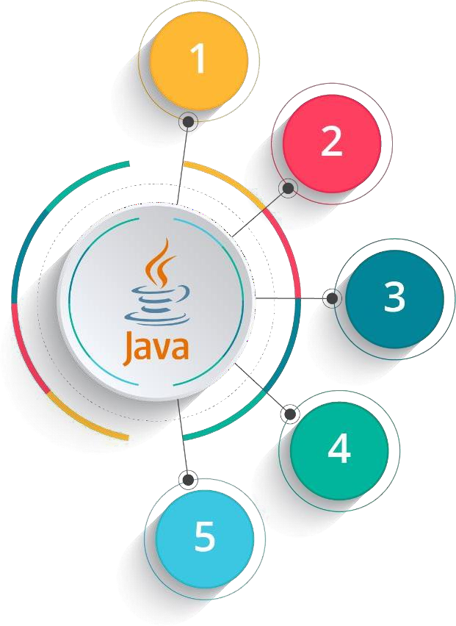
Course Outline
Introduction to Java
Data Handling and Functions
Object Oriented Programming in Java
Packages and Multithreading
Collections

Slide 3

Objectives
After completing this module, you should be able to:
Implement Single and Multi dimensional array
Declare and Define Functions
Call Functions by value and by reference
Implement Method Overloading
Use String data-type and String-buffer

Slide 4
Introduction to Arrays

Slide 5



Arrays
An array is a data structure which holds the sequential elements of the same type
For Example: Lets create an array for Democratic party from John’s project
Array always starts from the index 0.
0 1 2 3 4
E.g: array index 4 is holding a value of 200
Democratic Party
126 32 230 21 200
Each index in the array holds a value.

Slide 6
Arrays
An array is a data structure which holds the sequential elements of the same type
For Example: Lets create an array for Democratic party from John’s project
Array always starts from the index 0.
0 1 2 3 4
E.g: array index 4 is holding a value of 200
Democratic Party
126 32 230 21 200
Each index in the array holds a value.
Why do we use Arrays?
Arrays are an important structure to hold data
Java allows us to hold many objects of the same type using arrays and it can be used with the help of a loop to access the elements by their index

Slide 7


Declaring Arrays
Array can be declared in multiple ways:
data type
size of array
Starts
 | 0 | 1 | 2 | 3 | 4
 | 0 | 0 | 0 | 0 | 0
Ends
1
int[]a= new int[5];
Index has to be given in
square brackets

Slide 8


Declaring Arrays
Array can be declared in multiple ways:
data type
size of array
Starts
 | 0 | 1 | 2 | 3 | 4
 | 0 | 0 | 0 | 0 | 0
Ends
1
int[]a= new int[5];
Index has to be given in
square brackets
data type
size of array
Starts
0 | 1 | 2 | 3 | 4
0 | 0 | 0 | 0 | 0
2
int a[]= new int[5];
Ends
Index has to be given in square brackets

Slide 9
Declaring Arrays
Array can be declared in multiple ways:
data type
size of array
Starts
 | 0 | 1 | 2 | 3 | 4
 | 0 | 0 | 0 | 0 | 0
Ends
3
int[]a= {1,2,3,4,5};
Index has to be given in
square brackets

Slide 10
Declaring Arrays
Array can be declared in multiple ways:
data type
size of array
Starts
 | 0 | 1 | 2 | 3 | 4
 | 0 | 0 | 0 | 0 | 0
Ends
3
int[]a= {1,2,3,4,5};
Index has to be given in
square brackets
data type
size of array
0 | 1 | 2 | 3 | 4
1 | 2 | 3 | 4 | 5
Starts
Ends
4
int[]a= new int[]{1,2,3,4,5};
Index has to be given in square brackets

Slide 11

Declaring Arrays (contd.)
Arrays can be declared for primitive and non-primitive data types

Slide 12
Declaring Arrays (contd.)
Arrays can be declared for primitive and non-primitive data types
Instead of declaring int a1, a2, a3, a4....a100, we can declare int a[100]

Slide 13
Declaring Arrays (contd.)
Arrays can be declared for primitive and non-primitive data types
Instead of declaring int a1, a2, a3, a4....a100, we can declare int a[100]
It is fast and efficient to access an element in an array using the corresponding
index without actually traversing through the entire array

Slide 14
Declaring Arrays (contd.)
Arrays can be declared for primitive and non-primitive data types
Instead of declaring int a1, a2, a3, a4....a100, we can declare int a[100]
It is fast and efficient to access an element in an array using the corresponding
index without actually traversing through the entire array
The size of the array is fixed once it is created

Slide 15
Declaring Arrays (contd.)
Arrays can be declared for primitive and non-primitive data types
Instead of declaring int a1, a2, a3, a4....a100, we can declare int a[100]
It is fast and efficient to access an element in an array using the corresponding
index without actually traversing through the entire array
The size of the array is fixed once it is created
For Example: A character array of 10 characters can be declared as
-
char[]ch= new char[10];

Slide 16



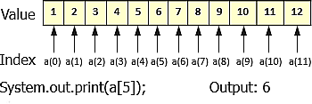

Types of Arrays
Single Dimensional Array
Multi Dimensional Array
Initialization:
int x[] = new int[12]
Initialization:
int x[][] = new int[5][5];
Index in dimension Y
0 1 2 3 4
0
1
2
3
4
Index in dimension X

Slide 17
How Single Dimensional Arrays are used?
Array can be initialized in this manner also:
class arrInit
{
public static void main (String[] args)
{
int i;
int[] a = {10, 20, 30, 40, 50};
for (i = 0; i < 5; i++) System.out.println (a[i]);
}
}
This program declares an array 'a' and initializes it with numbers 10, 20, 30, 40 and 50

Slide 18
Multi Dimensional Array
Multi dimensional arrays can be 2 dimensional as rows and columns similar to a matrix
It could be 3 dimensional with depth, height and breadth
Or it could be 'n' dimensional array as per the requirement
Usually 2 dimensional arrays are used to perform matrix operations
Like single dimensional arrays, multi dimensional arrays can be of primitive and non- primitive data type

Slide 19
Multi Dimensional Array
Multi-dimensional arrays can be declared as
int [][]a= new int [2][2];
char [][]a= new char[3][2];
float [][]a= new float[5][5];
2 x 2 dimensional int array
0
1
1 | 4
4 | 5
0
1
2 x 2 dimensional int array

Slide 20
Multi Dimensional Array
Multi-dimensional arrays can be declared as
int [][]a= new int [2][2];
char [][]a= new char[3][2];
float [][]a= new float[5][5];
x 2 dimensional int array
x 2 dimensional char array
0
1
0
1
0
s | a
g | v
v | d
0
1 | 4
4 | 5
1
1
2
2 x 2 dimensional int array
3 x 2 dimensional int array

Slide 21
Multi Dimensional Array
Multi-dimensional arrays can be declared as
int [][]a= new int [2][2];
char [][]a= new char[3][2];
float [][]a= new float[5][5];
x 2 dimensional int array
x 2 dimensional char array
5 x 5 dimensional float array
0
1
2
3
4
2.2 | 3.4 | 5.0 | 3.3 | 1.2
7.8 | 9.0 | 1.1 | 2.9 | 5.5
2.0 | 3.0 | 7.8 | 9.8 | 9.9
5.7 | 6.6 | 8.8 | 5.3 | 2.7
1.8 | 4.4 | 7.6 | 1.0 | 1.1
0
0
1
1
0
1
0
s | a
g | v
v | d
2
0
1 | 4
4 | 5
1
3
1
2
4
2 x 2 dimensional int array
3 x 2 dimensional int array
5 x 5 dimensional float array

Slide 22
Q
In Class Questions
1. How many bytes are allocated for the array x? int x[][] = new int[5][5];
2. Can we do multi dimensional array operations in single dimensional array? If yes, then why do we require
multi dimensional array?

Slide 23
A
In Class Questions - Solutions
How many bytes are allocated for the array x? int x[][] = new int[5][5];
Solution: An int element takes 4 bytes and array x can store 25 int elements. Hence total number of bytes taken
by x is 25*4 = 100
Can we do multi dimensional array operations in single dimensional array? If yes, then why do we require multi dimensional array?
Solution: We can perform all the operations of multi dimensional array in single dimensional array but when the data has more than one dimension, it will be easier to perform operations in multi dimensional array.

Slide 24
Function

Slide 25
01
Functions
A function/method has group of statements to be
executed
02
A function has a task to perform
A function is declared as -
Scope specifier modifier return type function name (arguments)
public static void say Hello(int a, int b)

Slide 26
Why do we use Functions ?
Function name
It is the name given to the function. Using function name, functions can
be invoked.

Slide 27

Why do we use Functions ?
Function name
It is the name given to the function. Using function name, functions can
be invoked.
Scope specifier
This option specifies the visibility of the function. It could be public, private, protected or default (package)

Slide 28

Why do we use Functions ?
Function name
It is the name given to the function. Using function name, functions can
be invoked.
Scope specifier
This option specifies the visibility of the function. It could be public, private, protected or default (package)
Modifier
This will change the meaning of the function. Some of the options could be final, static, native, synchronized etc.

Slide 29

Why do we use Functions ?
Function name
It is the name given to the function. Using function name, functions can
be invoked.
Scope specifier
This option specifies the visibility of the function. It could be public, private, protected or default (package)
Modifier
This will change the meaning of the function. Some of the options could be final, static, native, synchronized etc.
Return type
This option specifies the data that
will be returned by the function. It could be primitive data type or object.

Slide 30

Why do we use Functions ?
Function name
It is the name given to the function. Using function name, functions can
be invoked.
Scope specifier
This option specifies the visibility of the function. It could be public, private, protected or default (package)
Modifier
This will change the meaning of the function. Some of the options could be final, static, native, synchronized etc.
Arguments
This is optional but can be used.
Using this, one can pass values to the
function for computation.
Return type
This option specifies the data that
will be returned by the function. It could be primitive data type or object.

Slide 31
Different kinds of Functions
We use functions to provide different kinds of functionality
For example:
absolute()
To find the absolute value of a number

Slide 32
Different kinds of Functions
We use functions to provide different kinds of functionality
For example:
absolute()
To find the absolute value of a number
square()
To find the square of a number

Slide 33
Different kinds of Functions
We use functions to provide different kinds of functionality
For example:
absolute()
To find the absolute value of a number
square()
To find the square of a number
sqrt()
To find the square root of a number

Slide 34

What happens when a Function is Invoked?
When a function is called from the main method, main method() address is stored on top of the
stack
01
01
Function
Invoke
02
03

Slide 35
What happens when a Function is Invoked?
When a function is called from the main method, main method() address is stored on top of the
stack
01
01
Function
Invoke
Control jumps to execute the
function
02
02
03

Slide 36
What happens when a Function is Invoked?
When a function is called from the main method, main method() address is stored on top of the
stack
01
01
Function
Invoke
Control jumps to execute the
function
02
02
03
After executing the function, main method address is popped from the stack and main method
execution resumes
03

Slide 37
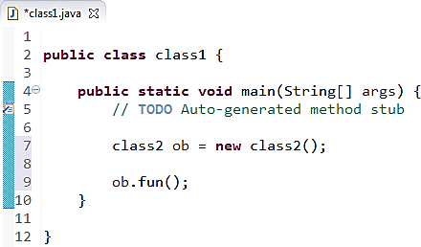


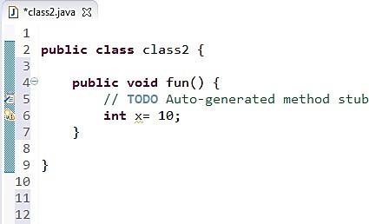
What happens when a Function is Invoked?
Stack
Step 1
ob(ref)
Heap ob Object
Ob(ref)

Slide 38
What happens when a Function is Invoked? (contd.)
Stack
Step 2
main (ref) Ob(ref)
Heap ob Object
Main
(ref)
Ob(ref)
Ob(ref)

Slide 39


What happens when a Function is Invoked? (contd.)
x = 10 main (ref) ob(ref)
Main (ref) Ob(ref)
Ob(ref)
Stack
Step 3
x = 10
main (ref) ob(ref)
Heap ob Object

Slide 40

What happens when a Function is Invoked? (contd.)
main (ref) ob(ref)
x = 10 main (ref) ob(ref)
Main (ref) Ob(ref)
Ob(ref)
Exiting Method
Stack
Step 4
fun()
main (ref) ob(ref)
Heap ob Object

Slide 41


What happens when a Function is Invoked? (contd.)
main (ref) ob(ref)
main (ref) ob(ref)
x = 10 main (ref) ob(ref)
Main (ref) Ob(ref)
Ob(ref)
Exiting Method main()
Stack
Step 5
main (ref) ob(ref)
Heap ob Object

Slide 42
Sample Program on Functions
Program to find square of a given number
public class testFunctions
{
//function to return square of a given number.
int static square (int x)
{
int y = x * x; return y;
}
public static void main (String[] args)
{
Scanner sc = new Scanner (System.in); System.out.println ("Please enter a number..."); int n = sc.nextInt();
int result = testFunctions.square (n); System.out.println ("Square of " + n + " is " + result);
}
}

Slide 43

Sample Program on Functions(contd.)
Program to find square of a given number
Stack
public class testFunctions
{
//function to return square of a given number. int static square (int x)
{
int y = x * x; return y;
}
Step 1
int n
public static void main (String[] args)
{
Scanner sc = new Scanner (System.in); System.out.println ("Please enter a number..."); int n = sc.nextInt();
int result = testFunctions.square (n); System.out.printl_{S}n_{te}(_{p}"Square of " + n + " is " + result);
}
2
}

Slide 44
Sample Program on Functions
Program to find square of a given number
public class testFunctions
{
//function to return square of a given number.
int static square (int x)
{
int y = x * x;
return y;
}
public static void main (String[] args)
{
Scanner sc = new Scanner (System.in);
System.out.println ("Please enter a number...");
int n = sc.nextInt();
int result = testFunctions.square (n);
} | } | System.out.println ("S_{S}q_{t}u_{e}a_{p}re of " + n + 2 | " is " + result);
Stack
Step 2
main(ref)
n

Slide 45
Sample Program on Functions (Contd.)
Program to find square of a given number
public class testFunctions
{
//function to return square of a given number.
Stack
Step 3
y x
main(ref)
n
int static square (int x)
{
int y = x * x;
return y;
}
public static void main (String[] args)
{
Scanner sc = new Scanner (System.in); System.out.println ("Please enter a number..."); int n = sc.nextInt();
int result = testFunctions.square (n); System.out.println ("Square of " + n + " is " + result);
}
Step
2
}

Slide 46
Sample Program on Functions (Contd.)
Program to find square of a given number
 | public class testFunctions
 | {
 | //function to return square of a given number.
 | int static square (int x)
 | {
 | int y = x * x;
 | return y;
 | }
k | public static void main (String[] args) {
 | Scanner sc = new Scanner (System.in);
 | System.out.println ("Please enter a number...");
 | int n = sc.nextInt();
 |  |  | int result = testFunctions.square (n);
 |  |  | System.out.println ("Square of " + n + " is " + result);
 |  | }
 | }
Stac
Step 4
result
y n

Slide 47





Polymorphism
Polymorphism means the system behaves differently in different programming context
Types of Polymorphism
Static
Polymorphism
Run Time Polymorphism
Function overloading is known as static time or compile time polymorphism
Inheritance is known as run time polymorphism

Slide 48
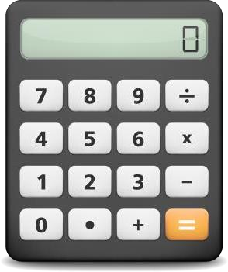
Function Overloading
Functions by different operators in a Calculator
÷ can divide:
→ two integers
→ two decimals
+ can add:
→ two integers
→ three integers
→ two decimals
→ three decimals

Slide 49

Function Overloading (contd.)
Addition is done using a function. If we did not have the concept of method overloading then the
calculator will have multiple plus buttons for the below tasks (each for a task):
→ | two integers | → | +
→ | three integers | → | ++
→ | two decimals | → | +++
→ | three decimals | → | ++++

Slide 50
Function Overloading (Contd.)
If many functions / methods have the same name but different arguments it is called Function Overloading
For Example:
If the user calls this method with integer data then the square method with
integer argument will be invoked
int square (int x);
Method name is same
double square(double x);
If the user calls this method with double data then the square method with double argument will be invoked.

Slide 51
Function Overloading (Contd.)
Function overloading does not depends on return type. It is differentiated only by the arguments of the
function.
For Example:
If the user creates two methods with same name and argument list but makes change in only return type then the method will not be overloaded and will result in syntax error
int square (int x);
Return type is
different
Method name and
argument is same
double square(int x);

Slide 52
Program on Function Overloading
public class FunctionOverloading
{
static int square (int x)
{
return x * x;
}
static double square (double x)
{
return x * x;
}
public static void main (String[] args)
{
int y = FunctionOverloading.square(10);
double z = FunctionOverloading.square (12.12); System.out.println("Square of 10 is " + y); System.out.println("Square of 12.12 is " + z);
}
}

Slide 53

Why do we use String?
If we declare character arrays then we have to write string handling methods by ourselves like length of the string, copying string, getting part of the string (sub string) etc.
01

Slide 54





Why do we use String?
If we declare character arrays then we have to write string handling methods by ourselves like length of the string, copying string, getting part of the string (sub string) etc.
01
String class is given in Java to handle multiple characters / Strings and
02 many methods are given in this class to handle the Strings
Multiple Character
char
Single Character
String

Slide 55
String
String is a class in Java to store string data
You can assign string data simply by defining
the string object and assign the string like this:
You can concatenate two string using + symbol.
For Example:
String str1 = “Hello”;
String str2 = “World”; String str3 = str1 + str2;
System.out.println (“Concatenated string is : “+str3);
String str;
String str = “Dursikshya”;
String str = new String();
String str = new String(“Dursikshya");
Out of the program is

Slide 56
String
String is a class in Java to store string data
You can assign string data simply by defining
the string object and assign the string like this:
You can concatenate two string using + symbol.
For Example:
String str1 = “Hello”;
String str2 = “World”; String str3 = str1 + str2;
System.out.println (“Concatenated string is : “+str3);
String str;
String str = “Dursikshya”;
String str = new String();
String str = new String(“Dursikshya");
Out of the program is
Appended string is: HelloWorld

Slide 57
String Functions
length()
Returns the length
of the string
L
length()

Slide 58
String Functions (Contd.)
length()
charAt(int)
Returns the length
of the string
Returns a character
at the specified position. Index of the String starts from 0
L
length()
C
charAt(int)

Slide 59
String Functions (Contd.)
length()
charAt(int)
Returns the length
of the string
Returns a character
at the specified position. Index of the String starts from 0
L
length()
C
charAt(int)
concat (String str)
CO
concat (String str)
It concatenates the
with the string object. It is same as using '+' operator for concatenation

Slide 60
String Functions (Contd.)
length()
charAt(int)
Returns the length
of the string
Returns a character
at the specified position. Index of the String starts from 0
L
length()
C
charAt(int)
concat (String str)
equals(String str)
CO
concat (String str)
E
equals(String str)
It concatenates the
with the string object. It is same as using '+' operator for concatenation
Checks whether string object and str and return true if they are same else returns false

Slide 61
String Functions (Contd.)
EqualsIgnoreCase (String str)
Same as other function except that this function ignores the case and checks for the equality of the strings
E
EqualsIgnoreCase (String str)

Slide 62
String Functions (Contd.)
EqualsIgnoreCase (String str)
indexOf(String str)
Same as other function except that this function ignores the case and checks for the equality of the strings
Returns the index of the specified string in the string object
E
EqualsIgnoreCase (String str)
I
indexOf(String str)

Slide 63
String Functions (Contd.)
EqualsIgnoreCase (String str)
indexOf(String str)
Same as other function except that this function ignores the case and checks for the equality of the strings
Returns the index of the specified string in the string object
E
EqualsIgnoreCase (String str)
I
indexOf(String str)
R
replace(char ch, char ch1)
replace(char ch, char ch1)
Replaces the character ch with Character ch1 in the string

Slide 64
String Functions (Contd.)
EqualsIgnoreCase (String str)
indexOf(String str)
Same as other function except that this function ignores the case and checks for the equality of the strings
Returns the index of the specified string in the string object
E
EqualsIgnoreCase (String str)
I
indexOf(String str)
R
replace(char ch, char ch1)
replace(char ch, char ch1)
lastIndexOf(String str)
L
lastIndexOf(String
str)
Replaces the character ch with Character ch1 in the string
Checks whether string object and str and return true if they are same else returns false

Slide 65
String Functions (Contd.)
toLowerCase()
Converts the given
string to lowercase
T
toLowerCase()

Slide 66
String Functions (Contd.)
toLowerCase()
toUpperCase()
Converts the given
string to lowercase
Converts the given
string to uppercase
T
toLowerCase()
TO
toUpperCase()

Slide 67
String Functions (Contd.)
toLowerCase()
toUpperCase()
Converts the given
string to lowercase
Converts the given
string to uppercase
T
toLowerCase()
TO
toUpperCase()
trim()
TR
trim()
Removes the leading
and trailing spaces of
the string

